Slide 1
ChatGPT in Rasa
Dr. Shuang LIANG
School of Software Engineering
TongJi University

Slide 2
ChatGPT training process

Slide 3
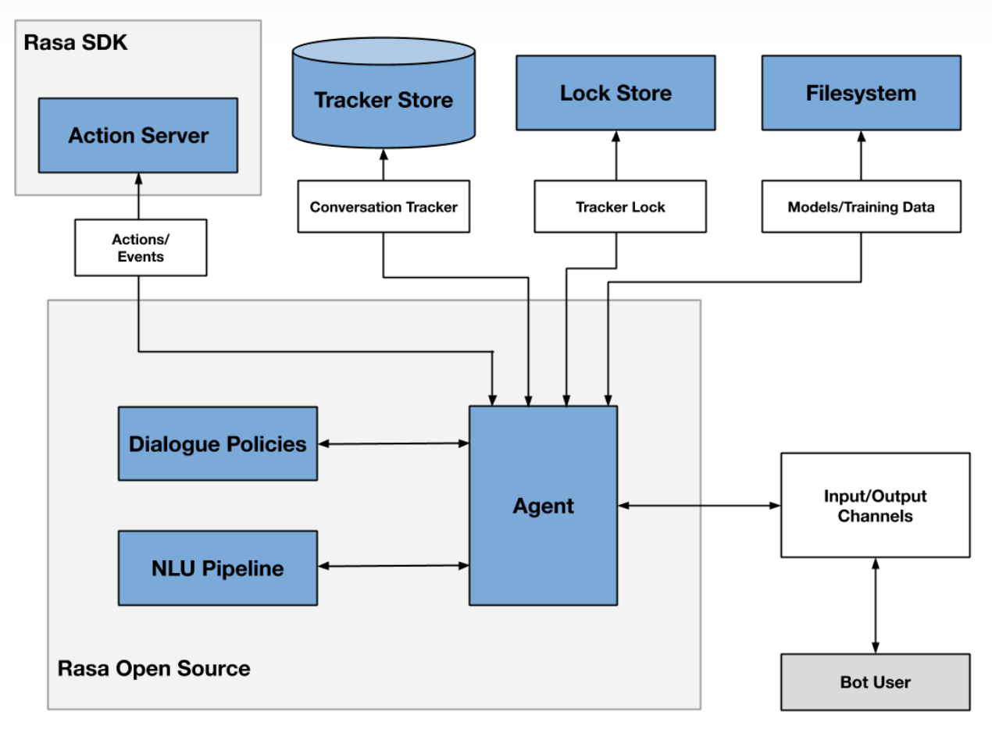
Rasa framework

Slide 4
Steps to call ChatGPT API in Rasa
You should follow the steps below to use ChatGPT and its API in Rasa:
download ChatGPT Desktop App (Not required when calling the API)
register
install openai
acquire your APIKEY
install rasa
create rasa project
call&run ChatGPT API in rasa project

Slide 5
Download ChatGPT Desktop APP
Select the version corresponding to your computer to download the desktop program：
macOS: https://github.com/lencx/ChatGPT/releases/download/v0.10.1/ChatGPT_0.10.1_x64.dmg
Windows: https://github.com/lencx/ChatGPT/releases/download/v0.10.1/ChatGPT_0.10.1_x64_en-US.msi
Linux: https://github.com/lencx/ChatGPT/releases/download/v0.10.1/chat-gpt_0.10.1_amd64.deb

Slide 6
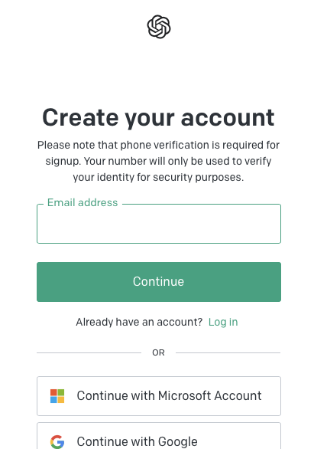
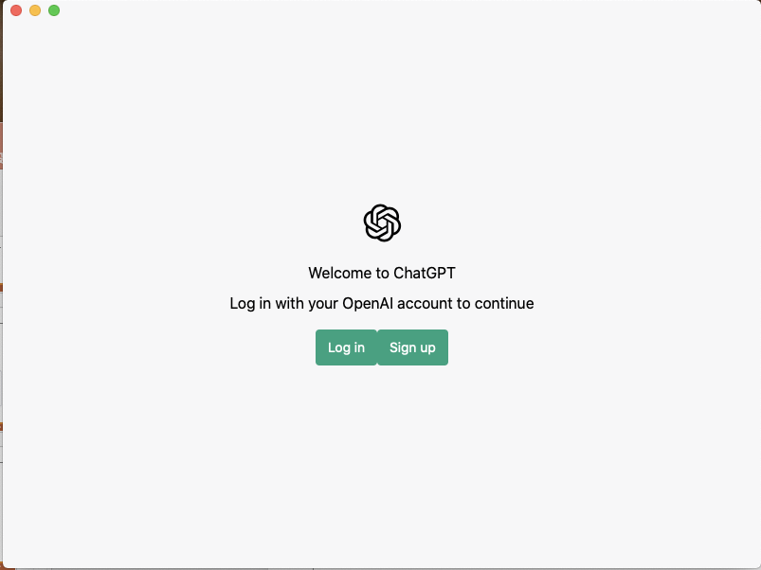
Register
When you open the desktop program for the first time, you need to register an account(You must connect to the VPN first, and note that the same IP cannot register more than 2 accounts)：

Slide 7

Register
When you open the desktop program for the first time, you need to register an account：

Slide 8
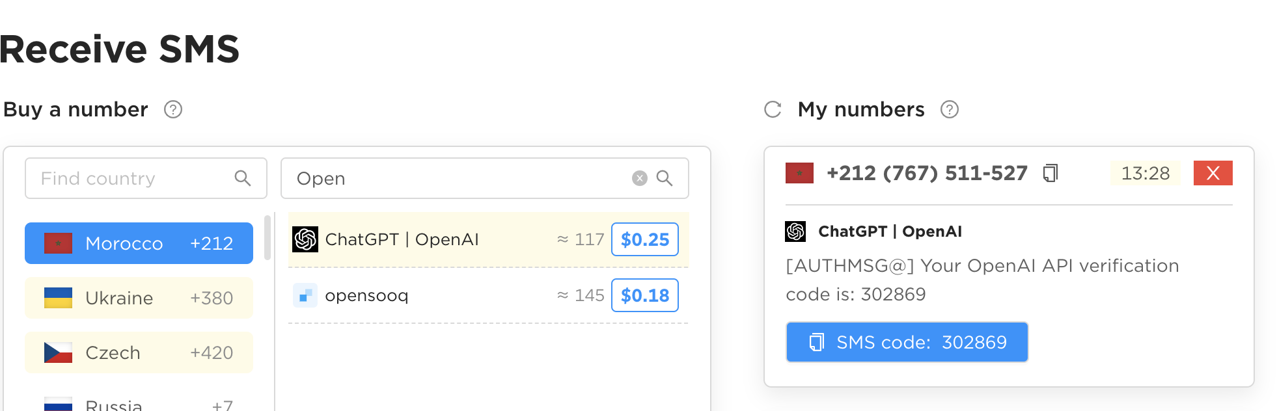
Register
A foreign mobile phone number is required to receive the verification code (not in Russia)：
Virtual phone number purchase website ：onlinesim.io

Slide 9
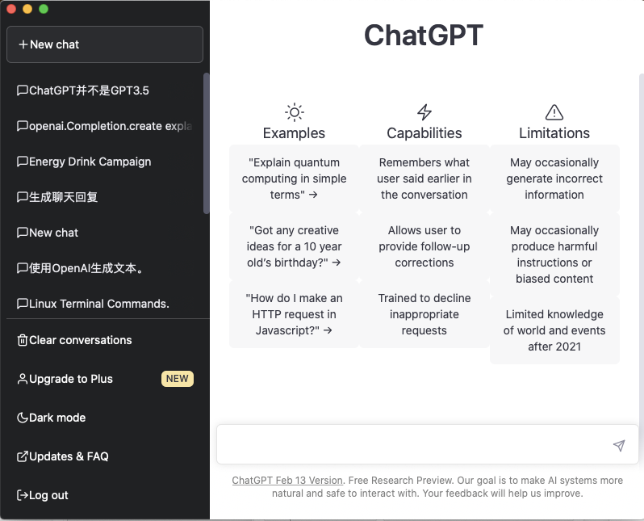
Register

Slide 10

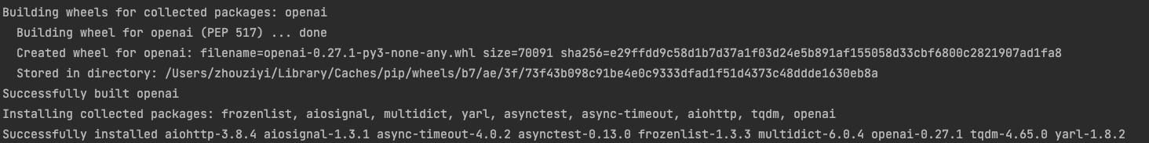
Install openai

Slide 11
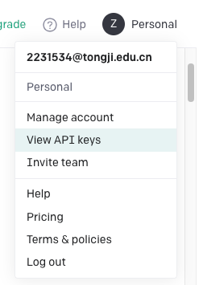
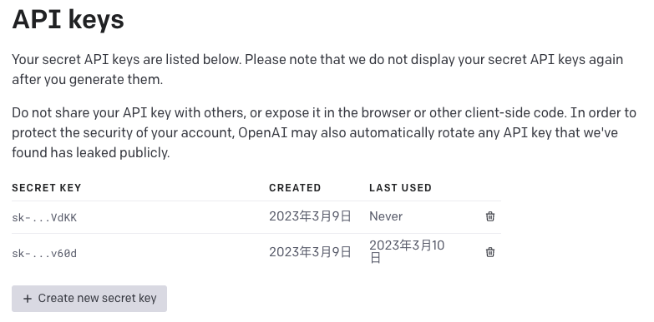
Acquire your APIKEY

Slide 12

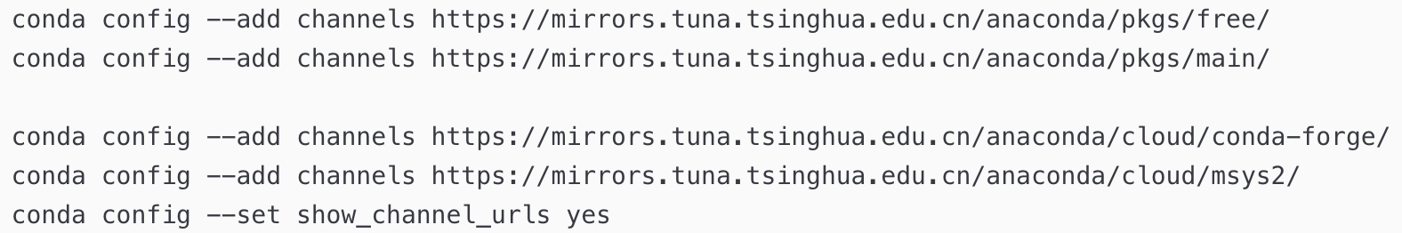
Install Rasa
Use VPN to make your installation faster, or configure Tsinghua mirror source：

Slide 13
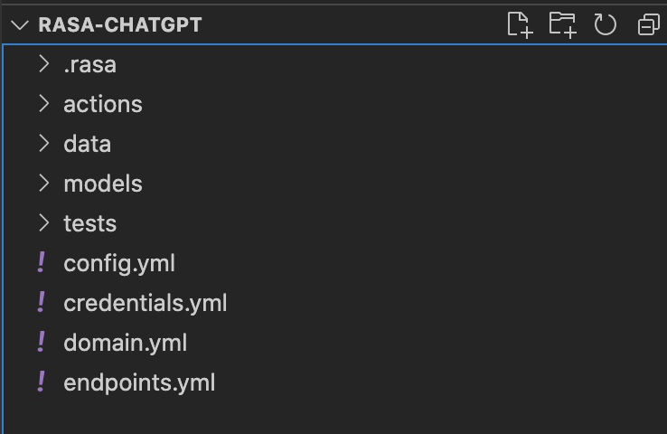
Create Rasa project
It is recommended to use VSCode to build the Rasa project, of course you can also choose Pycharm：
Create a new folder and open it in VSCode
Enter in the terminal of VSCode:
rasa init
You can find more explanations about these files in the search engine

Slide 14
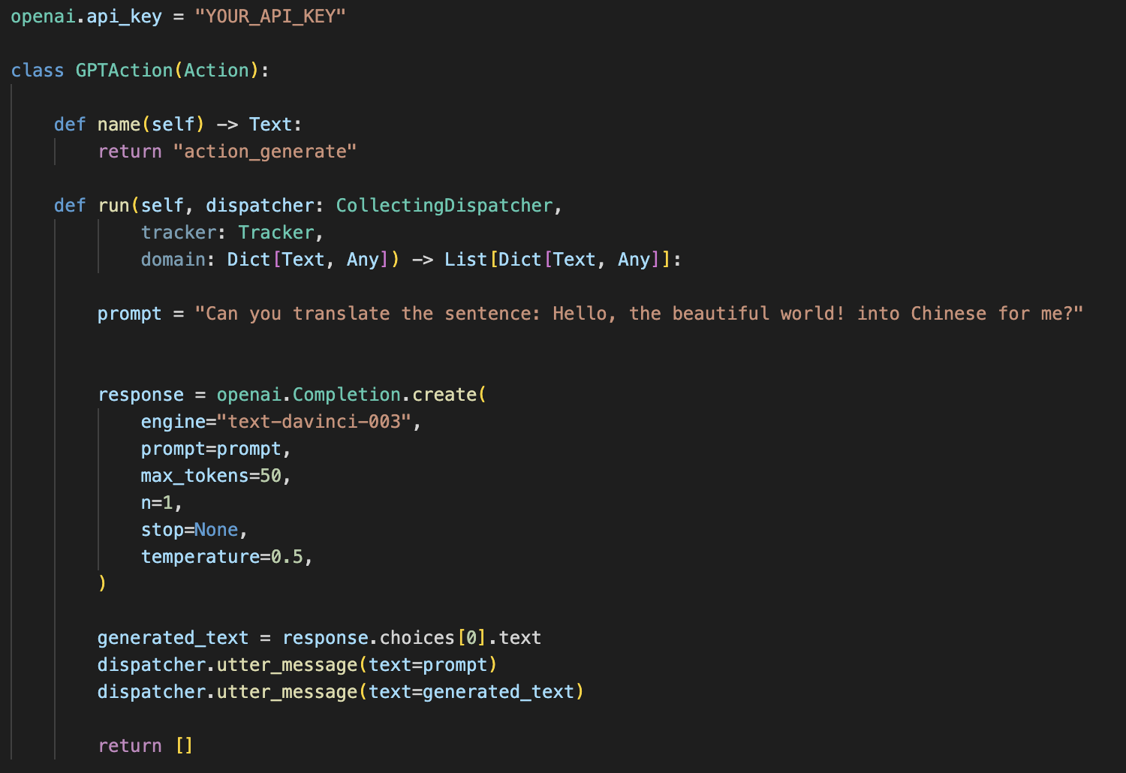
Call ChatGPT API in the rasa project
The sample code provides a simple self-defined operation to call the ChatGPT API code:
自定义的操作的名称
This class should be added to action.py

Slide 15
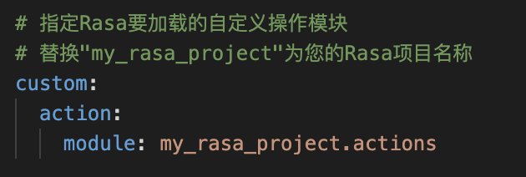
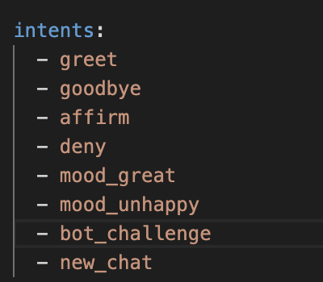
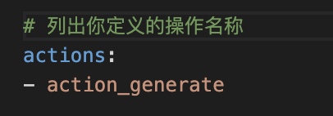
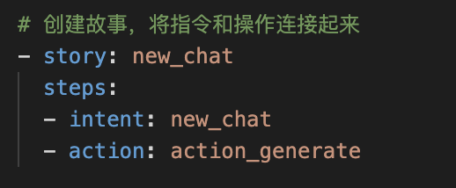
Call ChatGPT API in the rasa project
config.yml
domain.yml
stories.yml
将定义的指令添加进list

Slide 16
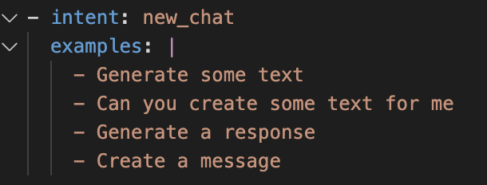

Call ChatGPT API in the rasa project
nlu.yml
endpoint.yml

Slide 17
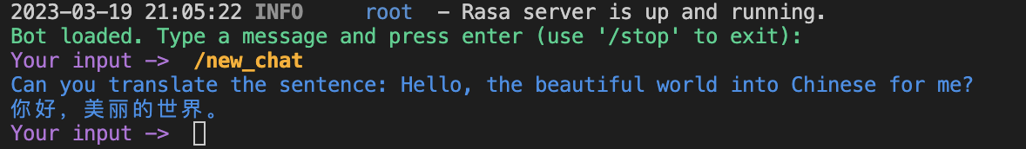
Run rasa project
rasa train
rasa run actions (run in a terminal)
rasa shell --endpoints endpoints.yml (run in another terminal)
There are more functions in Rasa that you can try according to your needs, but as long as you meet the requirements of the assignment, you can get full marks.

Slide 18
Assignment
Try to compare the difference and connection between openai.Completion.create and openai.ChatCompletion.create
Design your prompts to accomplish the following tasks in rasa:
When your favorite puppy or kitten passed away, you felt a deep sense of loss and longing for it. You would like ChatGPT to help you simulate its presence. Please describe its behavior and personality so that ChatGPT can better emulate it. Also, please create your first request to ChatGPT.
Let ChatGPT become a copywriter for WeChat Moments. Please make a request to this editor in the prompt. For example: 'Please use your imagination to the fullest', 'Please express in a literary way', or 'Please express in an indirect way'. Also, please provide your first instruction, such as describing the mood you want to convey or what kind of image you want to match.
Some examples of prompts are listed here for reference: https://github.com/f/awesome-chatgpt-prompts

Slide 19
Report
The report should answer the following questions (in English):
1. The difference and connection between openai.Completion.create and openai.ChatCompletion.create
2. The prompts you designed for the two cases：
According to the proposed requirements and prompt examples, design your own prompt, you can design multiple rounds of prompts and implement them in the code.
The prompt you design should be able to achieve the proposed goal, and have a certain richness and logic.
Submit your work (code and report)
Prepare a readme file to illustrate how to run your program
Compress all the codes and the report into a zip file: ID_name_lab2.zip
Submitted to canvas.tongji.edu.cn

